Slide 1

CARDIOVASCULAR DISEASE ANALYSIS Adam Butcher, Jose Flores, Elizabeth Jones, Xiaolong Liu, and Michael Villeda

Slide 2
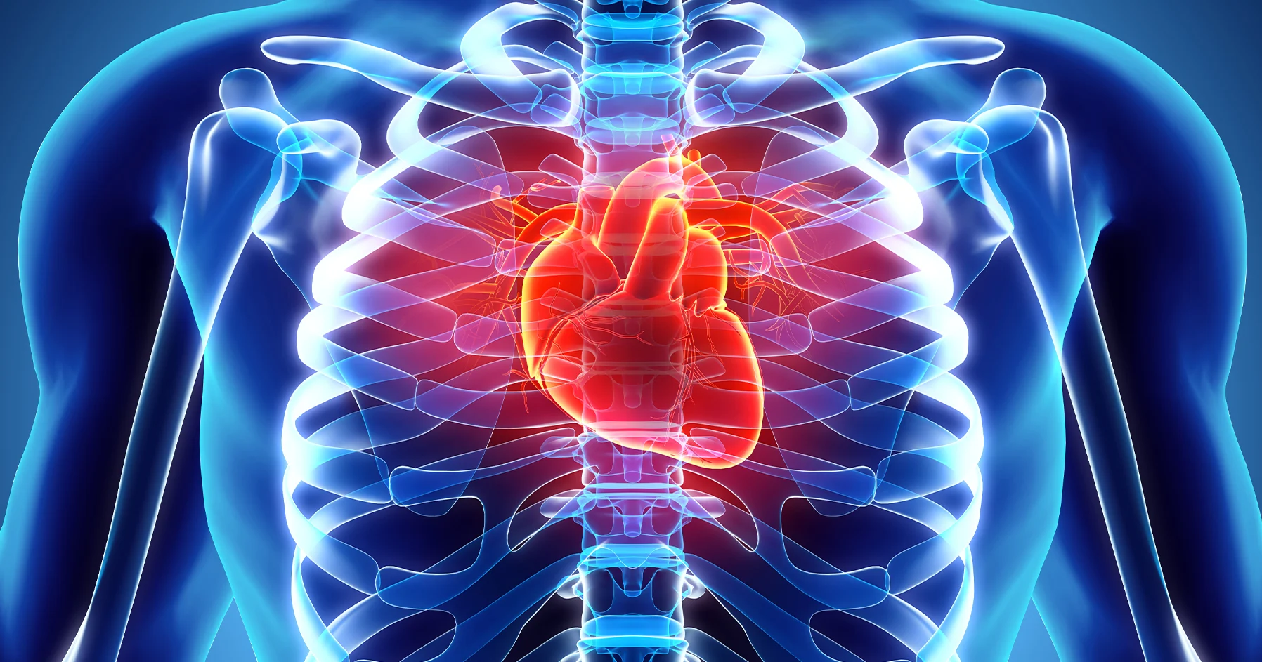
Introduction
Cardiovascular Disease is a term referring to conditions that affect the heart and blood vessels
Leading cause of death worldwide

Slide 3
CARDIOVASCULAR DISEASE ANALYSIS
We have identified important key trends that demand our attention.
Data reveals key correlations through bar plots, box plots, and regression plots, which highlight the relationship between lifestyle factors and cardiovascular disease.
Research underscores the impact of lifestyle factors such as diet, physical inactivity, and smoking, highlighting the need for comprehensive health education and intervention programs.
By understanding these evolving dynamics, we are empowered to innovate and adapt, ensuring we effectively address and meet emerging health needs.

Slide 4
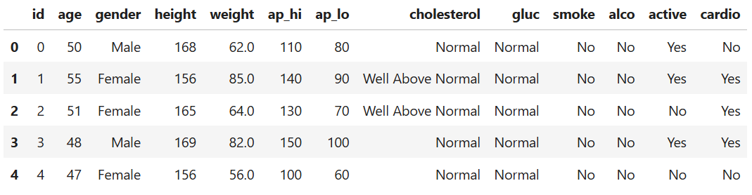
Dataset
Consist of 70,000 rows and 13 columns
Figure out the following questions:
What's the relationship between smoking and cardiovascular disease?
What's the relationship between cardiovascular disease and blood pressure?
What's the relationship between age and blood pressure?

Slide 5
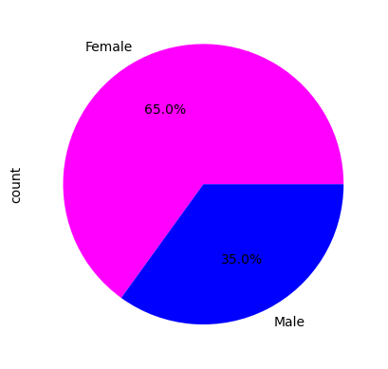
Participant demographic
Majority of participants in the study were female.
over half of those in the study were female and a low percentage (35%)
Despite the demographic shown it has little to no bias in terms of who smokes or doesn’t smoke

Slide 6
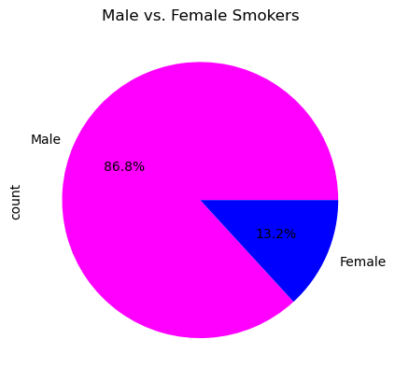
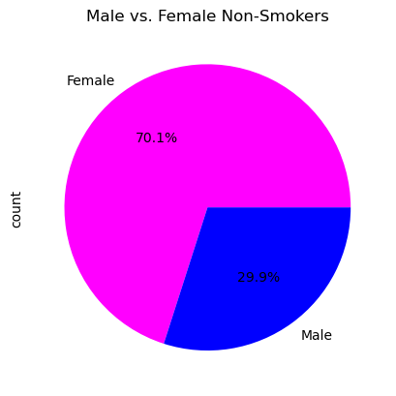
Smokers vs non smokers
With 35% of participants being male they made up 86% of smokers. The female participants only accounted for 13% of smoking . We see the opposite for non smokers. A majority of non smokers are female and about 30% of male’s are non smoking.

Slide 7
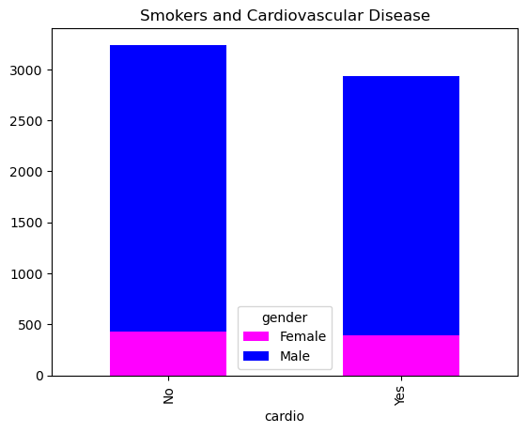
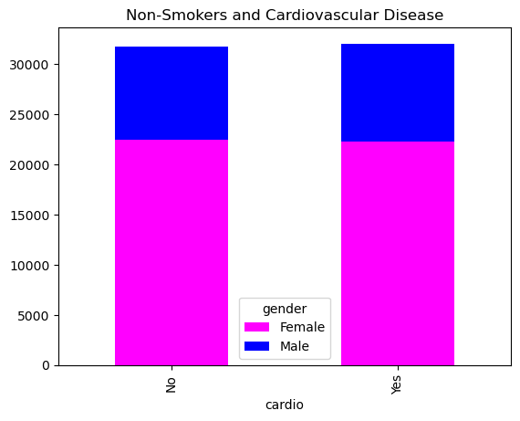
What's the relationship between smoke and cardio disease?
The majority of the smokers in our study were male.
The difference between female smokers that have cardiovascular disease and female smokers that don’t is negligible further proving that there is very little, if any correlation that smoking is a trigger or a causative of the disease.
The difference between male smokers that have the disease and male smokers that don’t is also very slight.
Therefore, smoking is not directly causing the Disease.
Both male and female non-smokers that do or don’t have the disease have the same population in our study.
This non-smoker vs cardio disease graph proves again that smoking is not the major cause of having cardiovascular disease.
In conclusion, our study based on the selected dataset shows that the cause of Cardio Disease does not directly correlate with smoking.

Slide 8
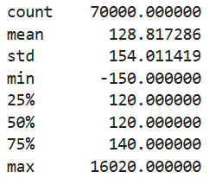
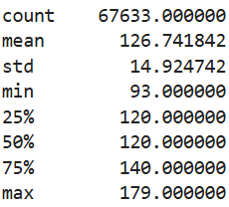
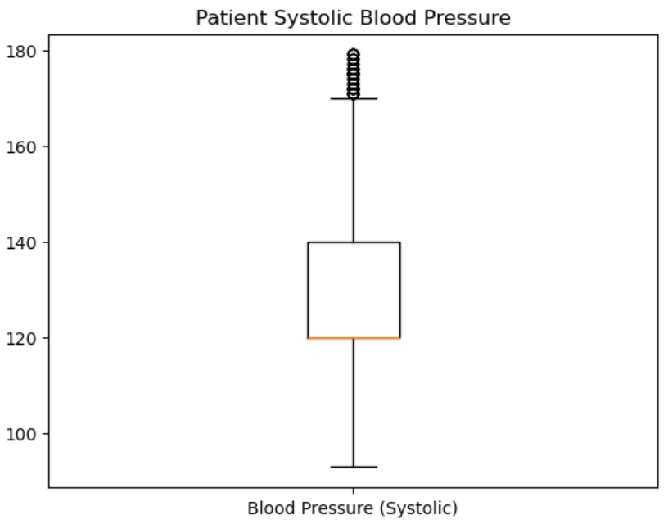
Relationship between cardiovascular disease and blood pressure
Data filtered to get rid of outliers so it is more realistic
Data is from 0.01-0.99 percentiles
Data reduced from 70,000 rows to 67,633 rows

Slide 9
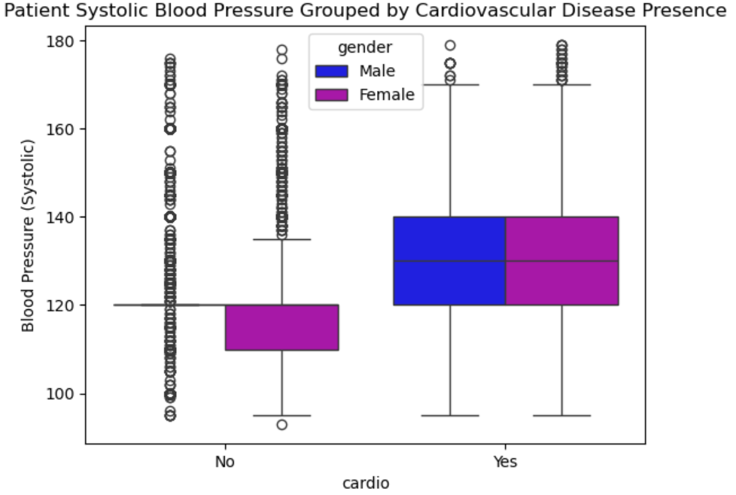
Relationship between cardiovascular disease and blood pressure (cont’d)
Cardiovascular Disease is more prevalent in people with higher blood pressure
Males and Females with Cardiovascular Disease have similar blood pressure

Slide 10
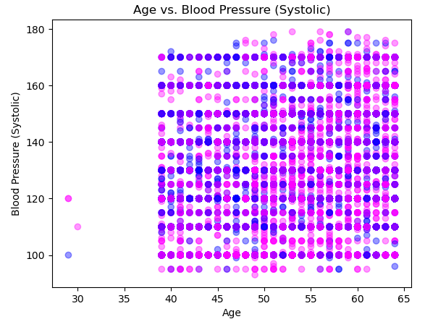
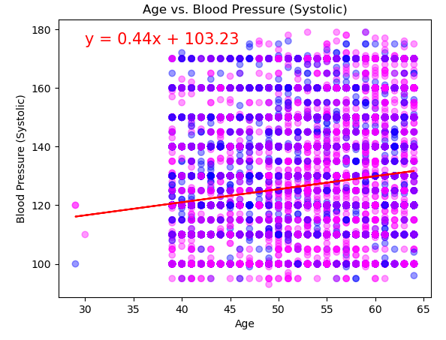
AGE VS. BLOOD PRESSURE (SYSTOLIC) SCATTER PLOTS
What's the relationship between age and blood pressure?
As our scatter plots show, while we do have a positive correlation, it is a coefficient of 0.2 which suggests a weak positive correlation between age and systolic blood pressure. This correlation implies that as age increases, systolic blood pressure tends to increase slightly. So, while there is a slight correlation, it’s essential to note that many variables influence blood pressure, such as diet, exercise, genetics, and lifestyle choices. This weak correlation suggests that age alone is not a strong predictor of systolic blood pressure. In conclusion this indicates that while there may be a slight tendency for blood pressure to rise with age, it is not a definitive relationship.

Slide 11
CONCLUSION
There is no relationship between smoking and cardiovascular disease, and males tend smoke more than females
People who have higher blood pressure tend to have cardiovascular disease
Weak positive relationship between age and blood pressure

Slide 12
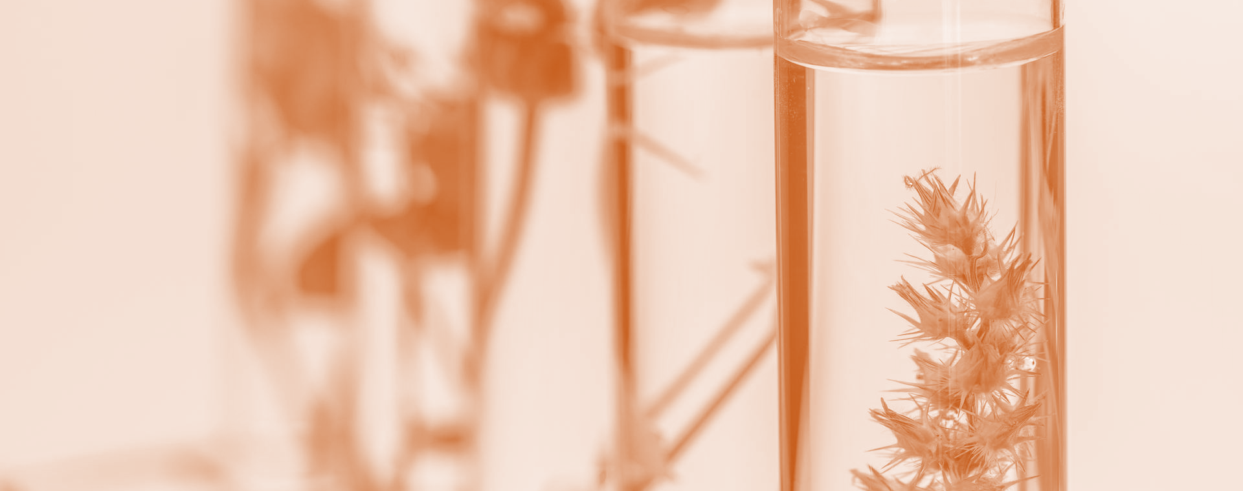
THANK YOU

